Slide 1


Intrusion Detection using CNN
A Deep Learning Approach for Surveillance Systems
under the ge of
Dr.SK.ALTHAF HUSSAIN BASHA M.Tech., Ph.D PROFESSOR DEPARTMENT OF COMPUTER SCIENCE AND ENGINEERING
SHAIK YASEEN-21JU1A05J7
KATAKAM YASWANTH-21JU1A05J8
DEVANDLA VENKATESWARLU-22JU5A0505
THANNEERU VINAY-21JU1A05J2
KRISHNA CHAITANYA INSTITUTE OF TECHNOLOGY AND SCIENCES

Slide 2
Introduction
Abstract
CNN-based system for real-time detection of suspicious activities
Targets activities like fighting, fire, theft, and shooting
Trained on diverse datasets for better generalization
Achieved ~99% detection accuracy
Adapts to various lighting conditions and camera angles
Reduces manual surveillance effort and human error
Scalable and efficient for modern security needs
KRISHNA CHAITANYA INSTITUTE OF TECHNOLOGY AND SCIENCES

Slide 3
Literature Survey
Traditional surveillance relies on manual monitoring by humans
Uses basic techniques like motion detection & object tracking
Limitations:
High false alarms
Poor adaptability to dynamic environments
Inability to learn new activity patterns
Deep learning, especially CNNs, revolutionized surveillance systems
CNNs automatically learn features from video data
KRISHNA CHAITANYA INSTITUTE OF TECHNOLOGY AND SCIENCES

Slide 4
Literature Survey
Key architectures:
AlexNet – first major CNN breakthrough
VGGNet – deeper network for finer feature extraction
ResNet – enables very deep learning without degradation
Widely used for activity recognition and anomaly detection in real-time
KRISHNA CHAITANYA INSTITUTE OF TECHNOLOGY AND SCIENCES

Slide 5
System Analysis – Existing System
Relies on manual video monitoring by human operators
Uses rule-based motion detection and object tracking
Struggles with changing lighting, angles, and cluttered backgrounds
Drawbacks:
High false positives and false negatives
Cannot detect unfamiliar or evolving suspicious behaviors
Limited scalability and adaptability
Requires constant human supervision
KRISHNA CHAITANYA INSTITUTE OF TECHNOLOGY AND SCIENCES

Slide 6
System Analysis – Proposed System
Implements CNN-based deep learning for behavior detection
Automates the full pipeline: video input → frame extraction → activity classification
Model is trained using 80% of labeled video dataset, tested on remaining 20%
Integrates advanced preprocessing to handle noisy input (e.g., lighting/camera angle)
Reduces false alarms with improved pattern recognition over traditional methods
Built for real-time video processing and detection alerts
Easily updatable with new training data to adapt to evolving threats
KRISHNA CHAITANYA INSTITUTE OF TECHNOLOGY AND SCIENCES

Slide 7
System Requirements - Hardware
Pentium IV Processor
4 GB RAM (min)
20 GB HDD
Standard Keyboard, Mouse, SVGA Monitor
KRISHNA CHAITANYA INSTITUTE OF TECHNOLOGY AND SCIENCES

Slide 8
System Requirements - Software
OS: Windows 7 Ultimate
Language: Python
Front-end: HTML, CSS, JavaScript
Framework: Django
Database: MySQL
KRISHNA CHAITANYA INSTITUTE OF TECHNOLOGY AND SCIENCES

Slide 9
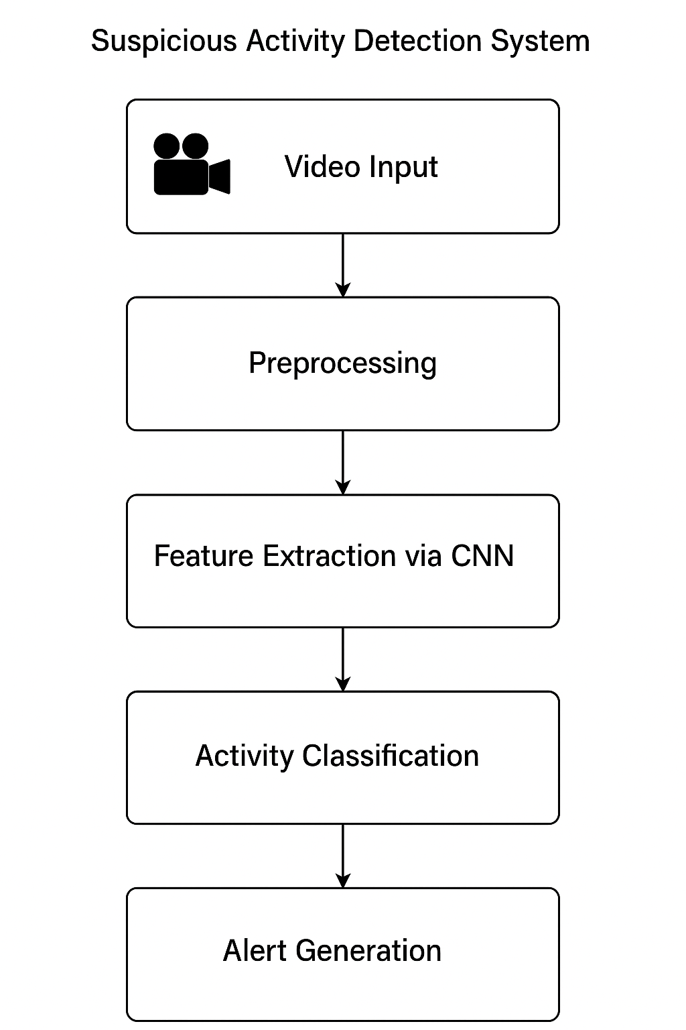

System Design – System Architecture
Video Input: Surveillance videos uploaded for analysis
Preprocessing: Frames extracted, resized, and normalized
Feature Extraction: CNN extracts key visual patterns from each frame
Activity Classification: Trained model classifies activities as normal or suspicious
Alert Generation: Alerts triggered for suspicious activity (e.g., fire, fight, theft)
Supports real-time, high-accuracy detection
Handles diverse environments and video quality
KRISHNA CHAITANYA INSTITUTE OF TECHNOLOGY AND SCIENCES

Slide 10
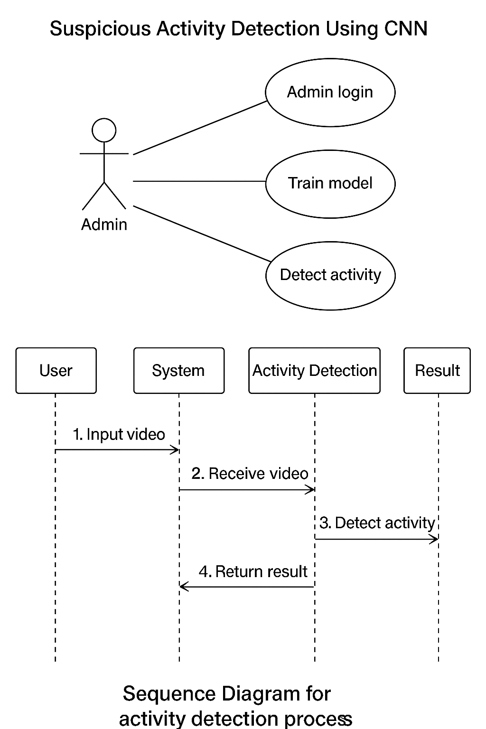
System Design – UML Diagrams
KRISHNA CHAITANYA INSTITUTE OF TECHNOLOGY AND SCIENCES

Slide 11
Software Environment
Programming Language: Python
Framework: Django (Backend)
Database: MySQL (via WAMP Server)
Frontend: HTML, CSS, JavaScript
Computer Vision: OpenCV
Deep Learning Libraries:
TensorFlow / Keras
NumPy
Matplotlib
IDE Used: PyCharm / Visual Studio Code
Operating System: Windows 7 Ultimate
KRISHNA CHAITANYA INSTITUTE OF TECHNOLOGY AND SCIENCES

Slide 12
Implementation Module 1: Admin Login
Provides secure access to the system for administrators
Admin authentication via username and password
Default credentials:
Username: admin
Password: admin
Redirects to admin dashboard upon successful login
Prevents unauthorized access to core functionalities like:
Training the model
Uploading and testing videos
KRISHNA CHAITANYA INSTITUTE OF TECHNOLOGY AND SCIENCES

Slide 13
Implementation Module 2: Video Upload
User-friendly interface for uploading surveillance videos
Allows selection of video files from local system
Supported formats: .mp4, .avi, .mov
Uploaded video is processed frame-by-frame
Prepares data for analysis by the CNN model
Enables real-time or batch detection of suspicious activity
KRISHNA CHAITANYA INSTITUTE OF TECHNOLOGY AND SCIENCES

Slide 14
Implementation Module 3: CNN Training
CNN model trained on labeled videos of suspicious activities
Activity classes include: Fight, Fire, Theft, Shooting, etc.
Dataset split:
80% for training
20% for testing
Model learns to extract spatial features from video frames
Achieved 99% accuracy on test dataset
Training initiated via “Train CNN Algorithm” option in admin panel
KRISHNA CHAITANYA INSTITUTE OF TECHNOLOGY AND SCIENCES

Slide 15
Implementation Module 4: Activity Detection
Initiated after model training is complete
Uploaded video is converted into individual frames
Each frame is passed through the trained CNN for analysis
Detection pipeline:
Frame extraction
Preprocessing
CNN prediction
Display of classification result on video
Detection continues until end of video or manual stop (q key)
Supports live feedback with visual alerts for detected threats
Designed to work with different video sources and qualities
KRISHNA CHAITANYA INSTITUTE OF TECHNOLOGY AND SCIENCES

Slide 16
Testing and Validation – I
Dataset Source: Publicly available surveillance and activity videos
Training Video Folder includes labeled clips for each suspicious activity
Activity Classes Used:
Fight
Fire
Burglary
Shooting
Theft
Videos represent varied environments and angles for robustness
Model trained on 80% of data, tested on remaining 20%
Aim: Ensure system generalizes well across diverse scenarios
KRISHNA CHAITANYA INSTITUTE OF TECHNOLOGY AND SCIENCES

Slide 17
Testing and Validation – II
Model Accuracy: Achieved 99% accuracy on test dataset
Evaluation Metrics:
Precision: High – few false positives
Recall: High – most suspicious events correctly detected
F1-Score: Balanced score reflecting strong model performance
Consistent results across different activity classes (Fight, Fire, etc.)
Detection performance remains robust under:
Varying lighting conditions
Different camera angles
Background noise and motion
Demonstrates model reliability for real-time applications
KRISHNA CHAITANYA INSTITUTE OF TECHNOLOGY AND SCIENCES

Slide 18
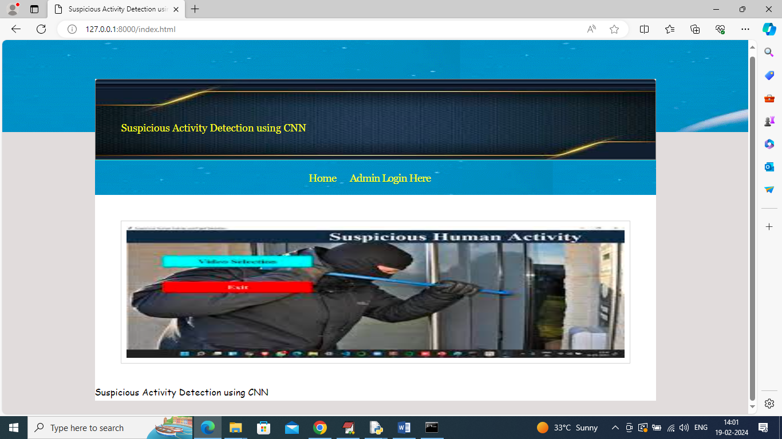
Sample Screenshot – Homepage
Homepage Interface: index.html loaded via Python web server
Launched at URL: http://127.0.0.1:8000/index.html
Clean user interface for navigation
Contains a clickable ‘Admin Login’ link
Entry point for system access and model operations
Screenshot illustrates initial web application landing page
KRISHNA CHAITANYA INSTITUTE OF TECHNOLOGY AND SCIENCES

Slide 19
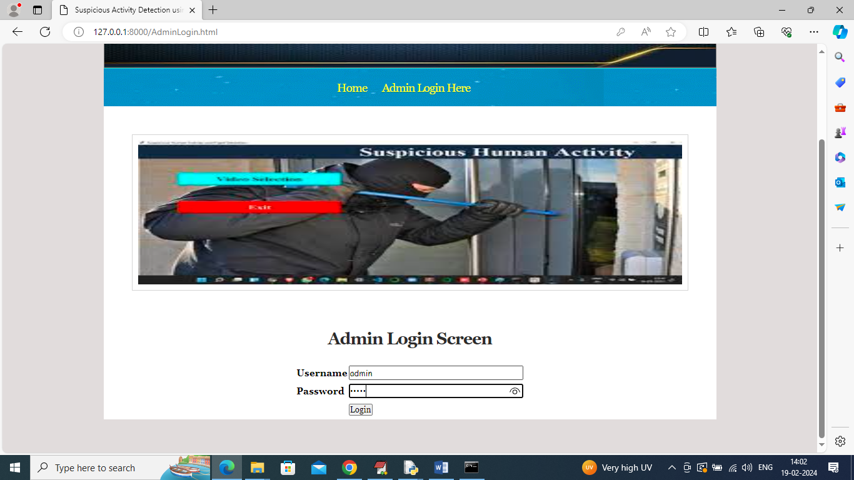
Sample Screenshot – Admin Login
Admin Login Page accessed via homepage link
Requires username and password (default: admin/admin)
Secure gateway to core functionalities
On successful login, redirects to Admin Dashboard
Dashboard provides access to:
CNN model training
Video upload and detection modules
Screenshot showcases authentication and interface layout
KRISHNA CHAITANYA INSTITUTE OF TECHNOLOGY AND SCIENCES

Slide 20
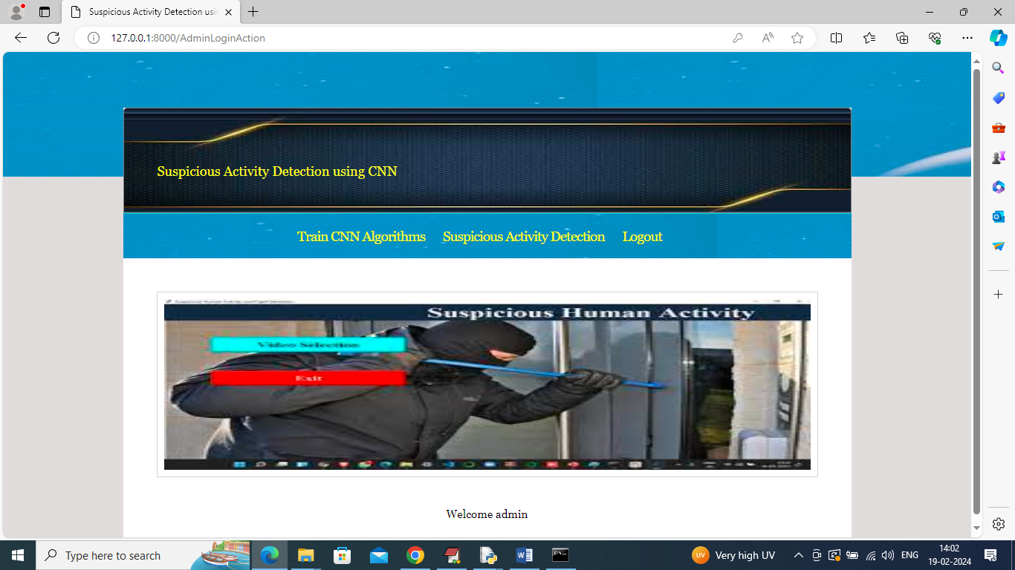
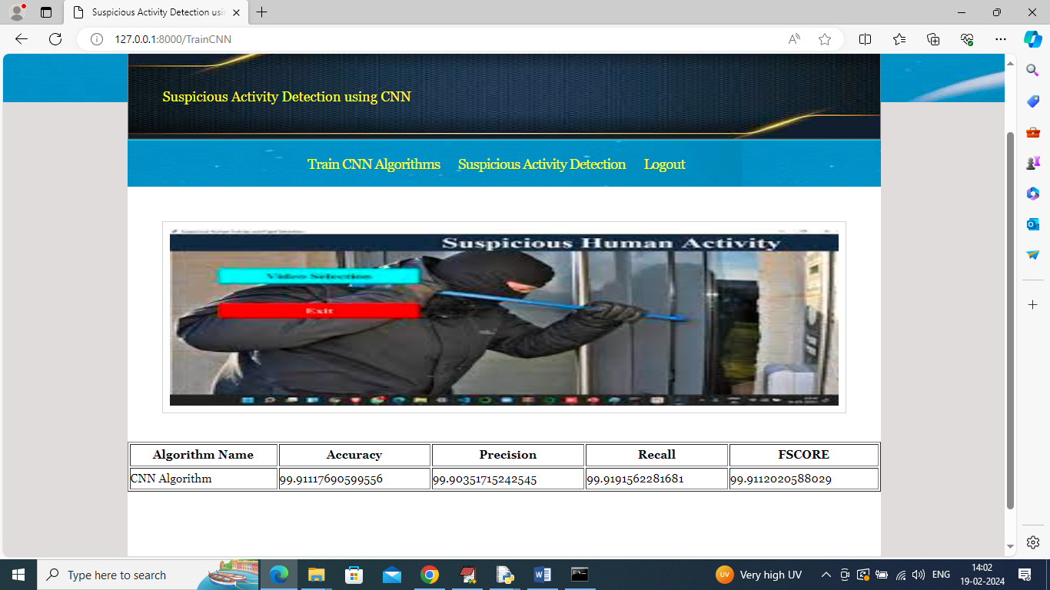
Sample Screenshot – CNN Training
CNN Training initiated from Admin Dashboard
Uses labeled video dataset for model training
Training progress displayed in real-time
System shows confirmation once training is complete
Achieved Accuracy: ~99% on test dataset
Screenshot includes:
Training status
Accuracy summary
Completion message
KRISHNA CHAITANYA INSTITUTE OF TECHNOLOGY AND SCIENCES

Slide 21
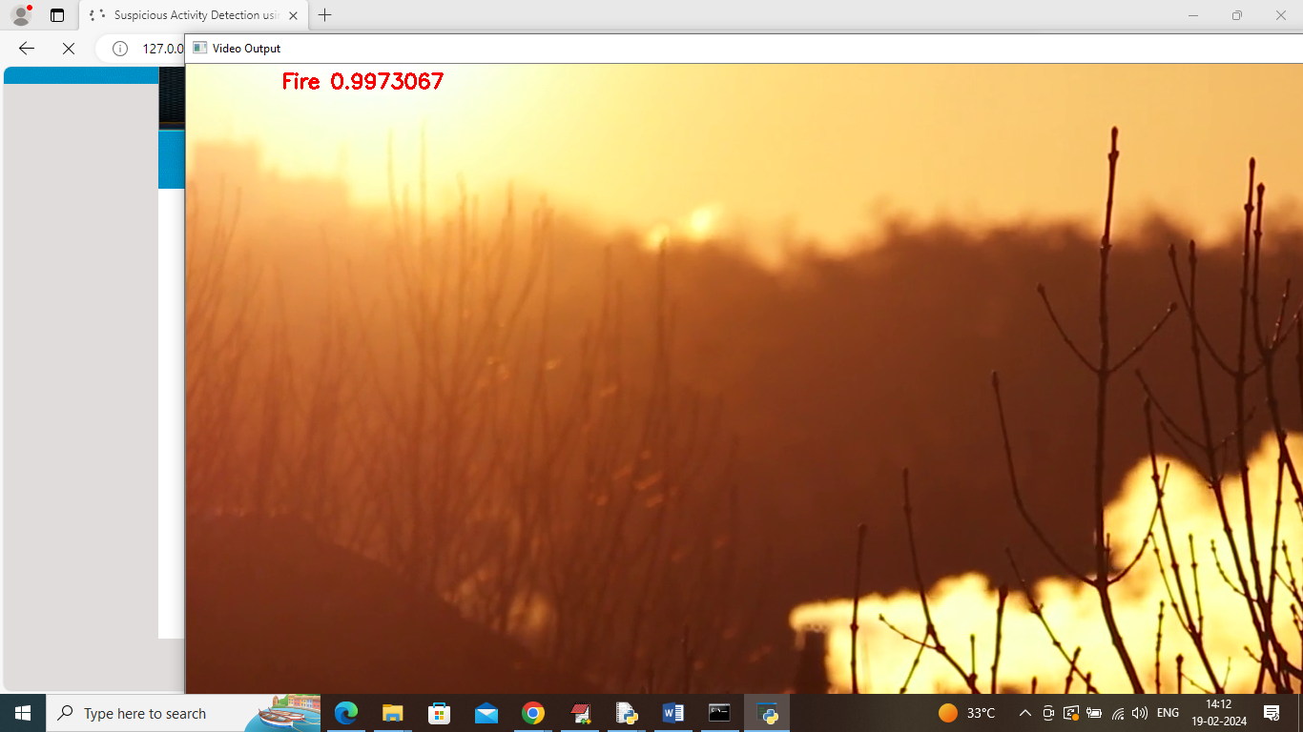
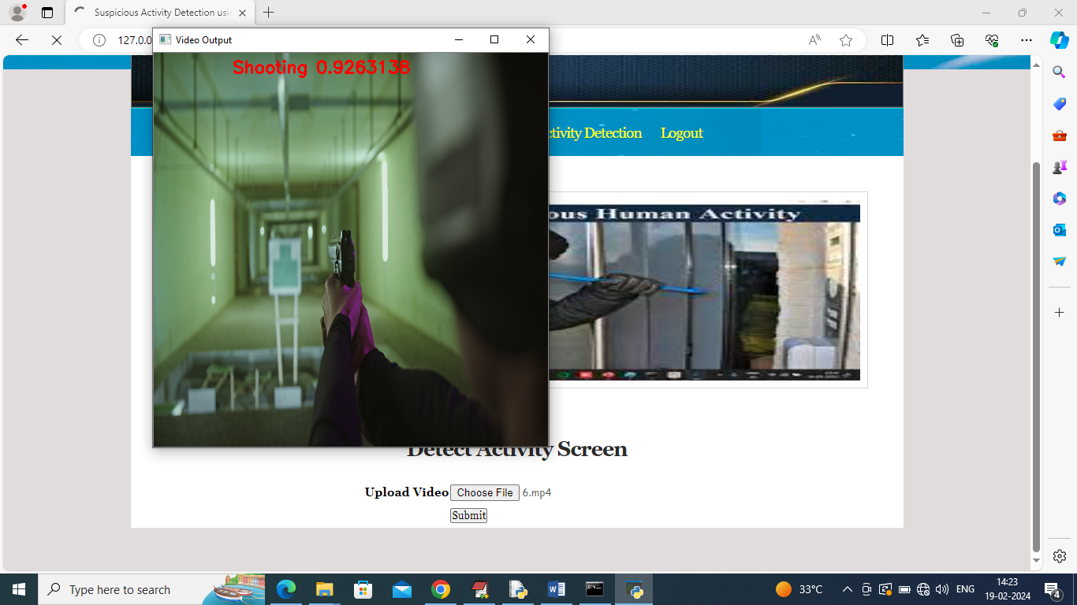
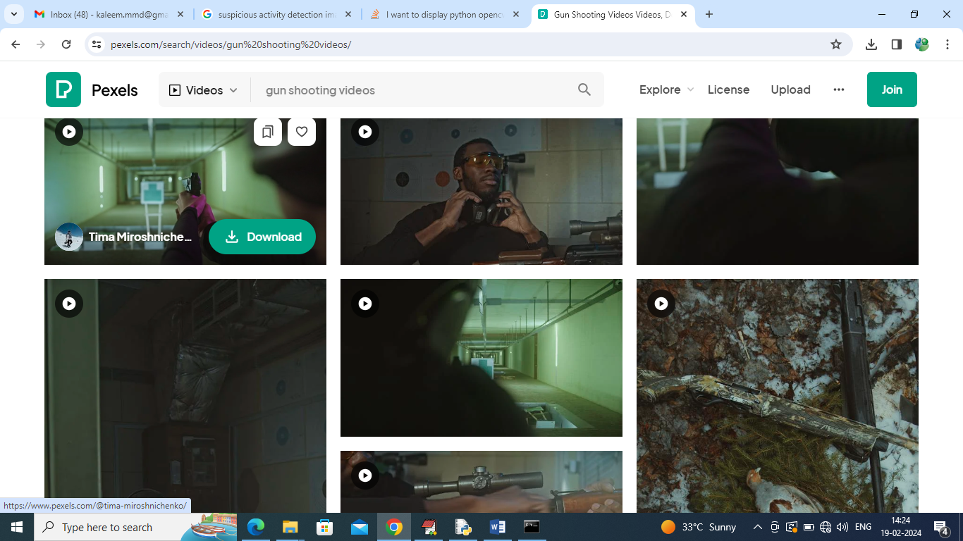
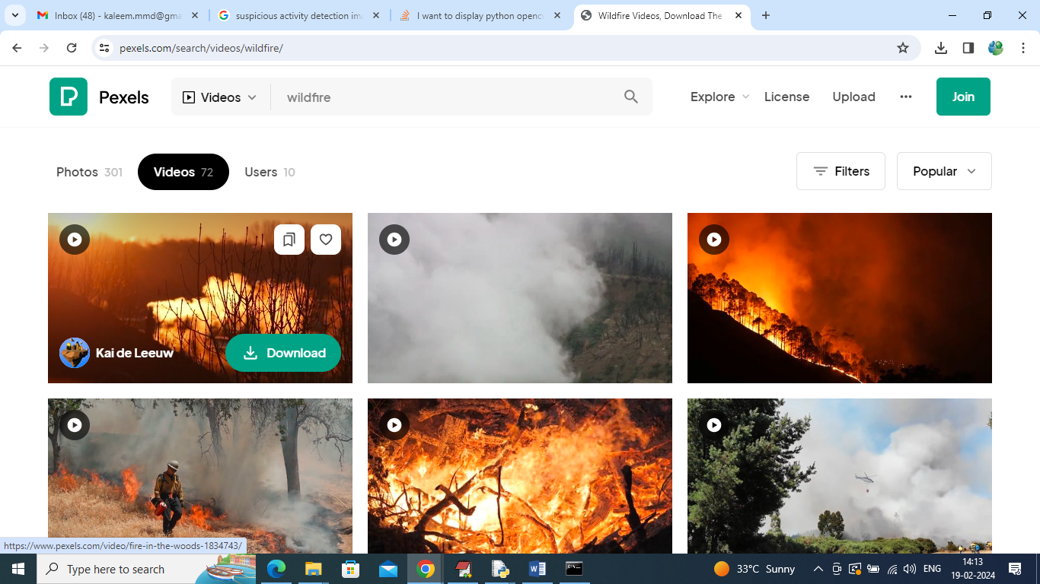
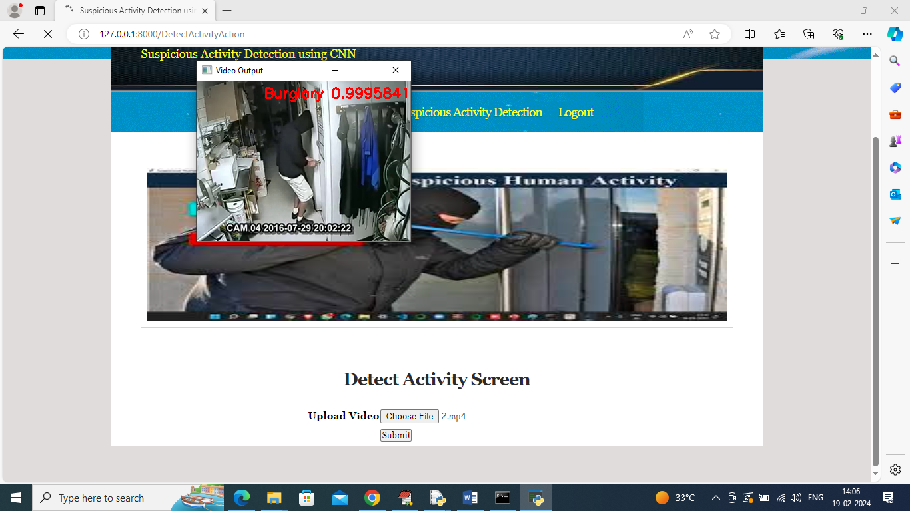
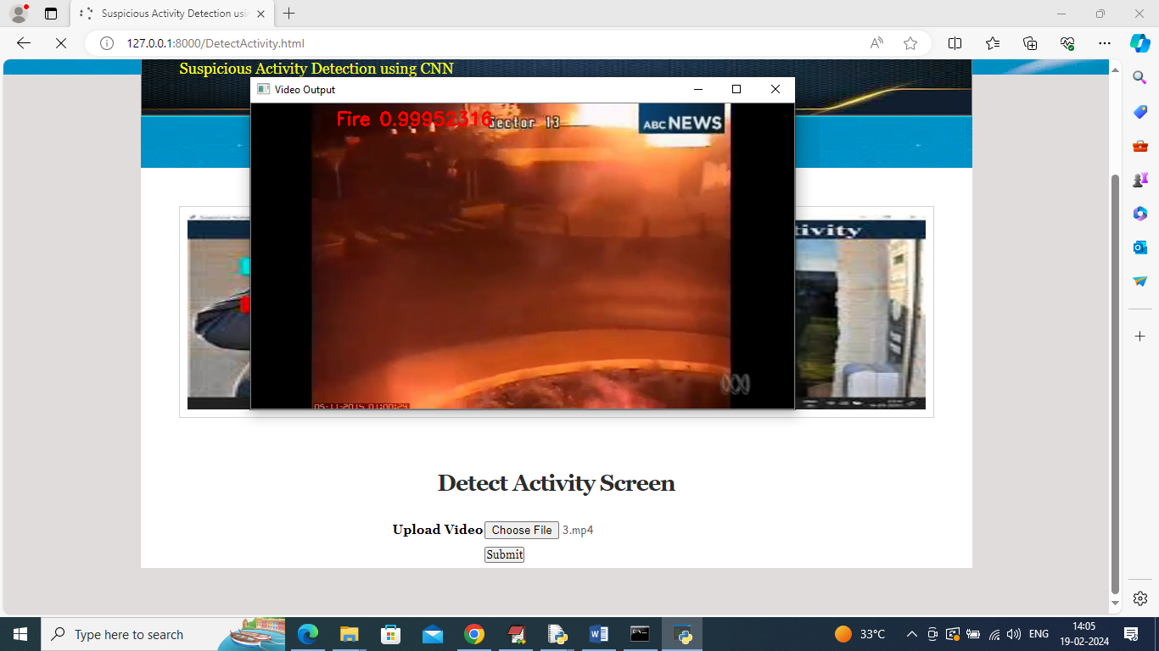
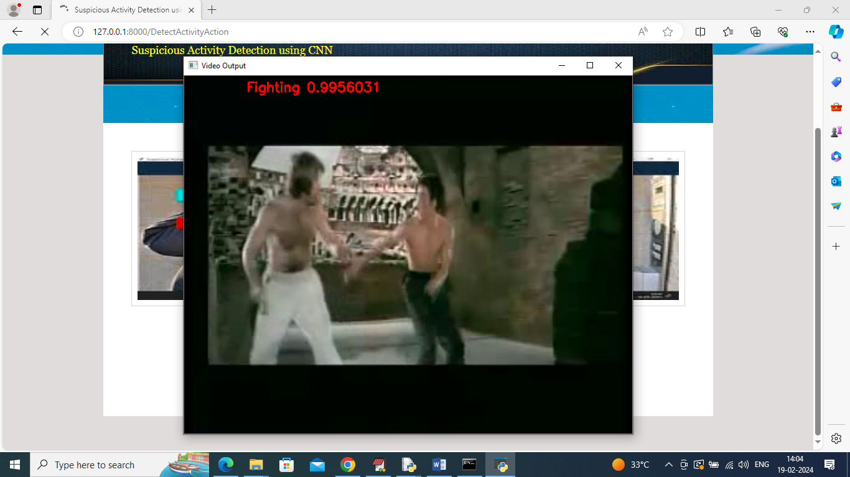
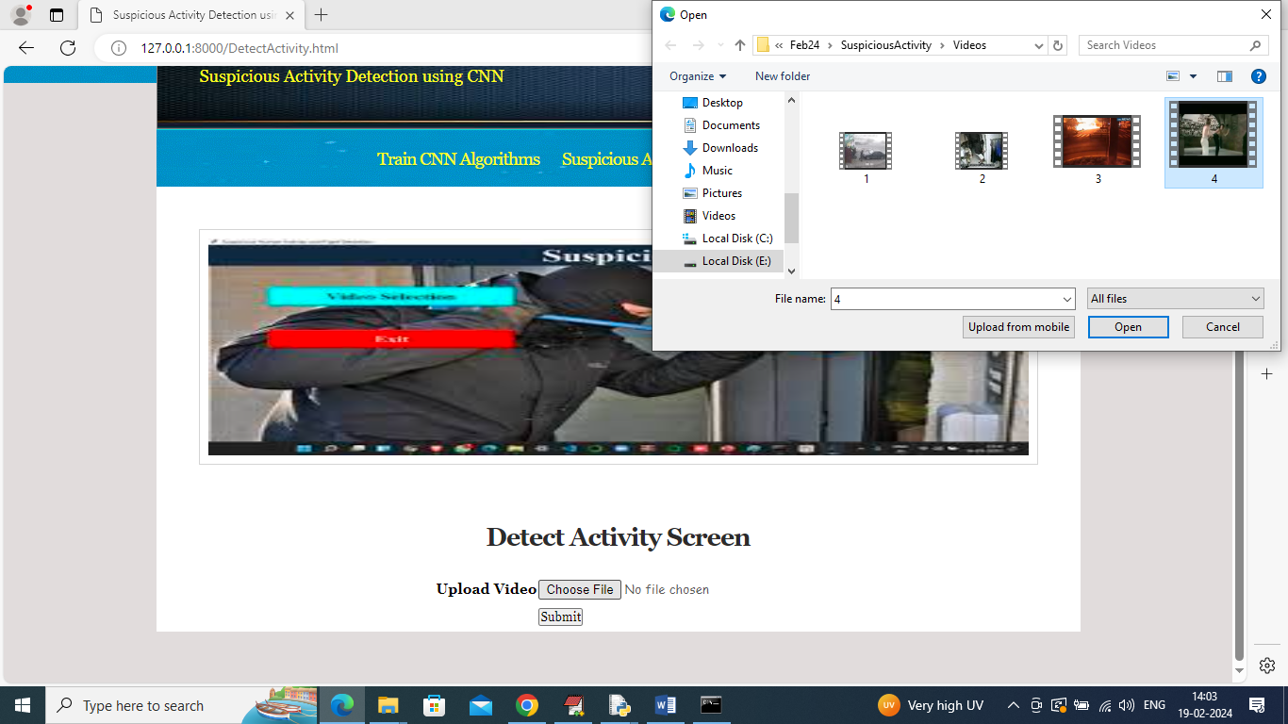
Sample Screenshot – Detection Output
Video Upload Interface: Allows user to select and upload video for analysis
User clicks ‘Open’ and ‘Submit’ to start detection
System processes video frame-by-frame using trained CNN model
Detection results are overlaid on the playing video
Examples of detected activities:
Fighting – Detected in action scenes
Fire – Detected in emergency clips
Theft/Burglary – Identified in relevant scenarios
Detection can be stopped anytime using the q key
KRISHNA CHAITANYA INSTITUTE OF TECHNOLOGY AND SCIENCES

Slide 22
Conclusion
CNNs automate suspicious activity detection from video feeds
Significantly reduce human error in surveillance monitoring
Suitable for real-time surveillance applications
Adaptable to various environments (lighting, angles, etc.)
Scalable and updatable with new data
Promotes innovation in security and AI-based surveillance
KRISHNA CHAITANYA INSTITUTE OF TECHNOLOGY AND SCIENCES

Slide 23
Future Scope
Develop lightweight CNN architectures for resource-constrained and edge devices
Enhance interpretability to better understand model decisions
Implement strategies to reduce bias and improve fairness in training datasets
Conduct real-world deployment trials for performance evaluation in live environments
KRISHNA CHAITANYA INSTITUTE OF TECHNOLOGY AND SCIENCES

Slide 24
References
Krizhevsky et al. (2012) – ImageNet with CNNs
Simonyan & Zisserman (2014) – VGG Networks
He et al. (2016) – ResNet: Deep Residual Learning
Kang & Lee (2020) – CNN-based Surveillance Detection
LeCun et al. (2015) – Overview of Deep Learning
KRISHNA CHAITANYA INSTITUTE OF TECHNOLOGY AND SCIENCES

